Slide 1
caCORE SDK
Code Generator
caBIG Developer Boot Camp
Satish Patel

Slide 2
Agenda
What is caCORE SDK code generator
What is required to use code generator
Data Service – what is it?
Data service creation with code generator
Running the code generator
Testing the generated system
Demonstration
Look inside the generated application

Slide 3
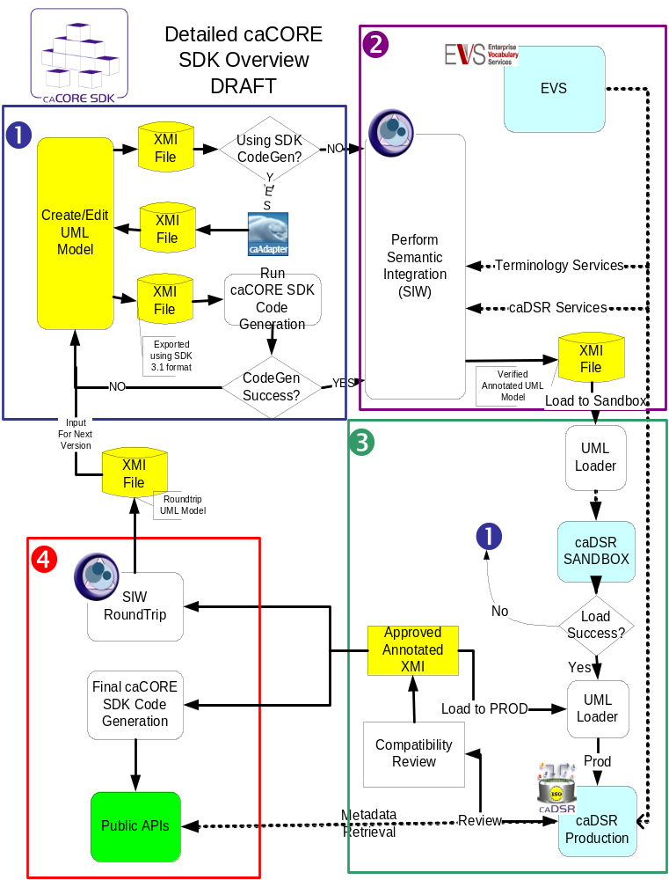
SDK Workflow
Design system and draw model
(UML tool)
Annotate model
(Semantic Connector)
Register metadata
(UML Loader)
Generate and deploy system (Code Generator)

Slide 4
What is caCORE SDK - Code generator?
Framework to generate Data Services
Simple tool to build application for collaborative research environment
Enables users to quickly build the silver level APIs
Built using open source tools and technologies
Open source and open development effort

Slide 5
What is Required to Use Code Generator
Must have working knowledge of
  UML class diagrams
  Enterprise Architect
  Java
Nice to have knowledge about
  Hibernate
  Web applications
  XML

Slide 6
Required Software
Enterprise Architect (version 6.5)
Java Development Kit - JDK (version 1.4.2 or above)
JBoss (version 4.0.4) or Apache Tomcat (version 5.5.19)
Apache Ant version (version 1.6.5)
Internet Explorer (version 5.5 or above)
and caCORE SDK Code Generator

Slide 7

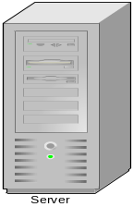
Data Service – What Is It?
A service that allows data owners to share the data from source like relational database (e.g. oracle) with their collaborators
caCORE SDK Generated System
OR
Custom Built Application
Human readable interface (GUI)
Database
Machine readable interface (Java API / Webservice)

Slide 8
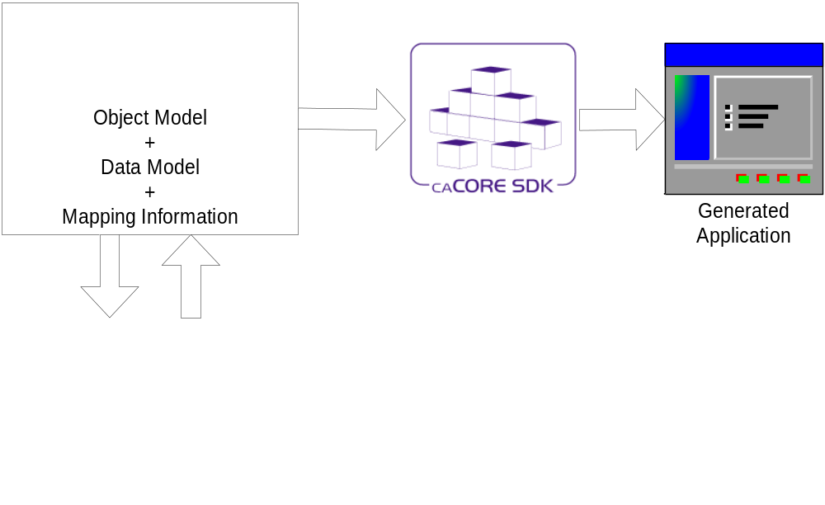
Data service creation with code generator

Slide 9
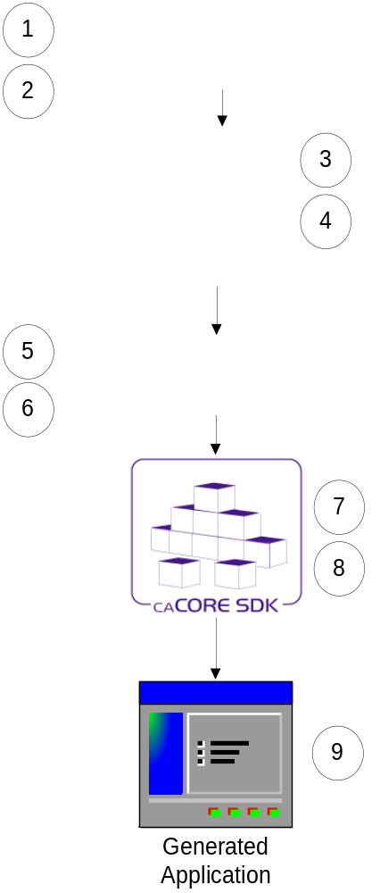
Running the Code Generator
Create Object Model (Enterprise Architect)
Create Data Model (Enterprise Architect)
Perform Object to Table mapping (caAdapter)
Perform Attribute to Column mapping (caAdapter)
Import the model (Enterprise Architect)
Re-export the model in XMI format
Configure the code generator
Run the code generator
Run generated system
Note: Steps 3 to 5 can be performed in Enterprise Architect without using caAdapter.
Assumption: Database is already configured and tables are populated with data

Slide 10
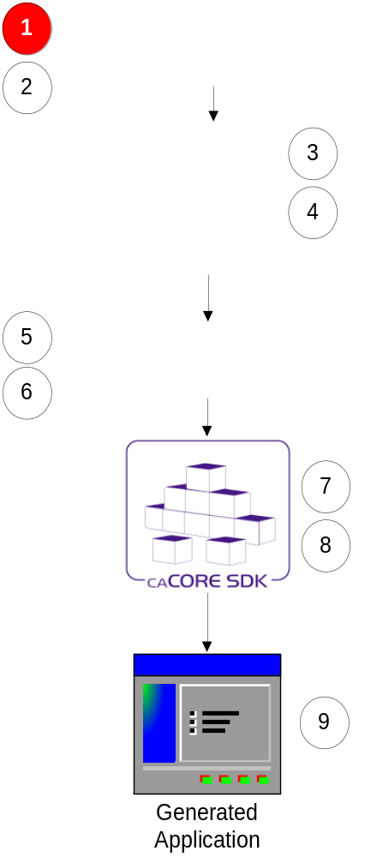
Step 1:
Creating Object Model (Enterprise Architect)
Define classes and its attributes
Define associations between classes
Always follow naming conventions mentioned in programmer’s guide

Slide 11
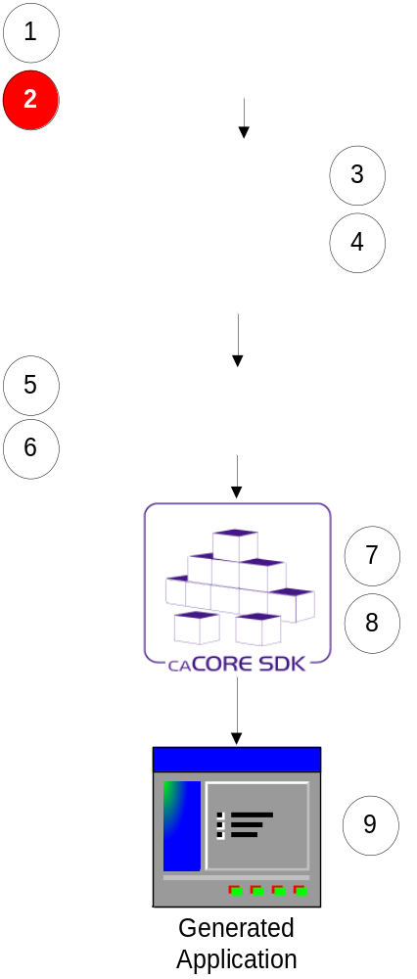
Step 2:
Creating Data Model (Enterprise Architect)
Define tables and its columns
Define primary key and foreign key constraints

Slide 12
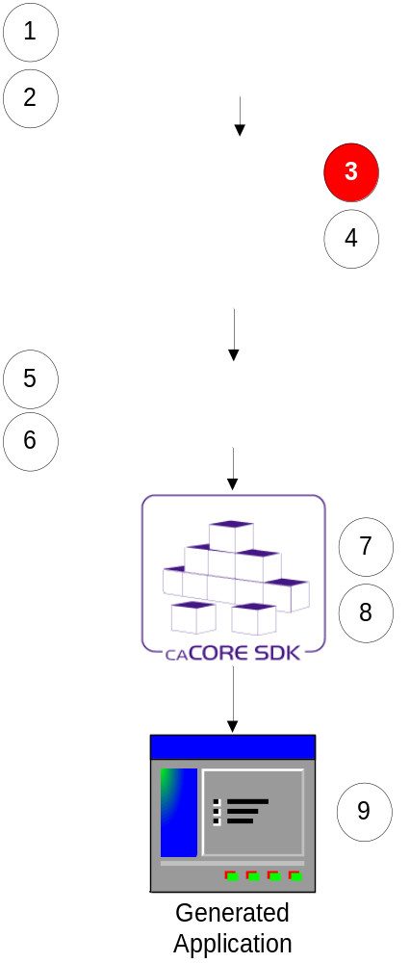
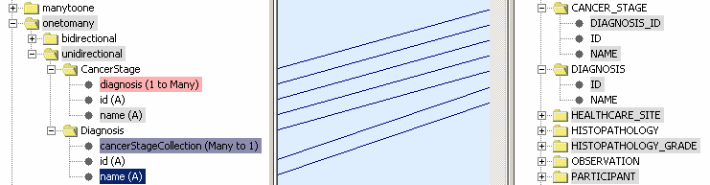
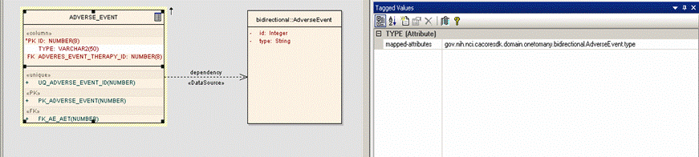
Step 3: Perform Class to Table Mapping
(caAdapter or Enterprise Architect)
Create Dependency link between a Class and a Table

Slide 13
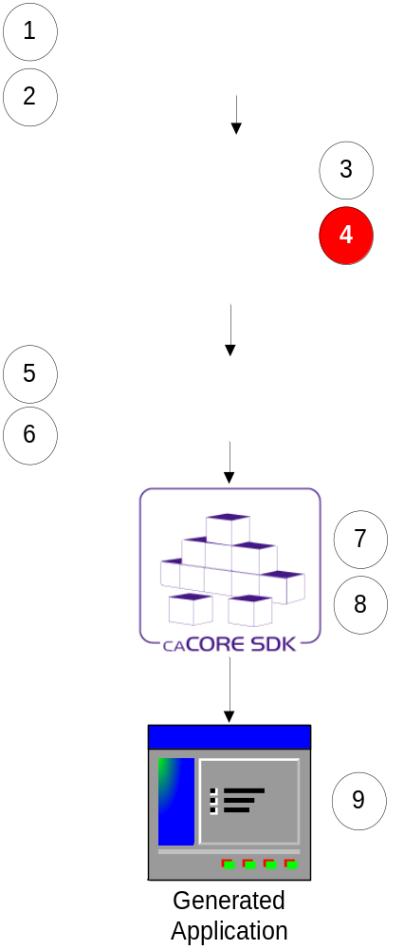
Step 4: Perform Attribute to Column Mapping
(caAdapter or Enterprise Architect)
Create link between a class attribute and table column using a Tag Value

Slide 14
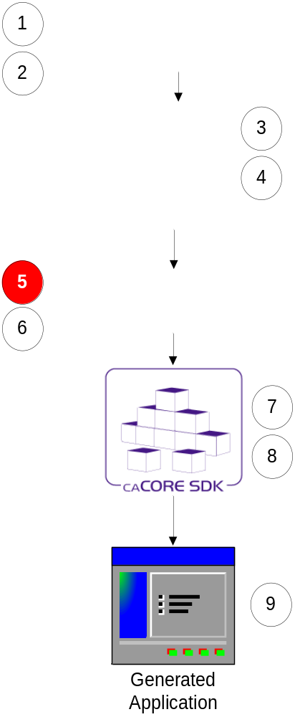
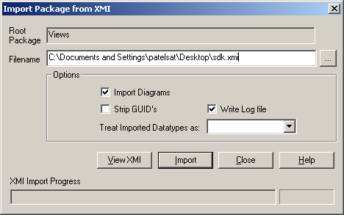
Step 5:
Import UML Model (Enterprise Architect)
Import model modified by caAdapter in Enterprise Architect

Slide 15
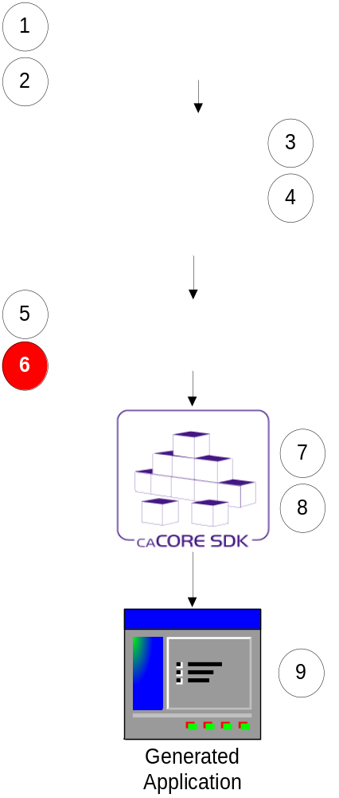
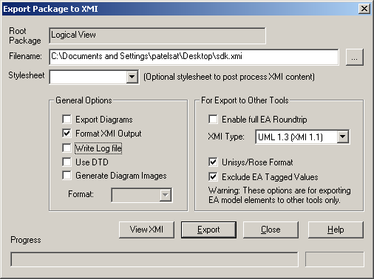
Step 6:
Re-export UML Model (Enterprise Architect)
Export model modified from Enterprise Architect using code generator specific export options

Slide 16
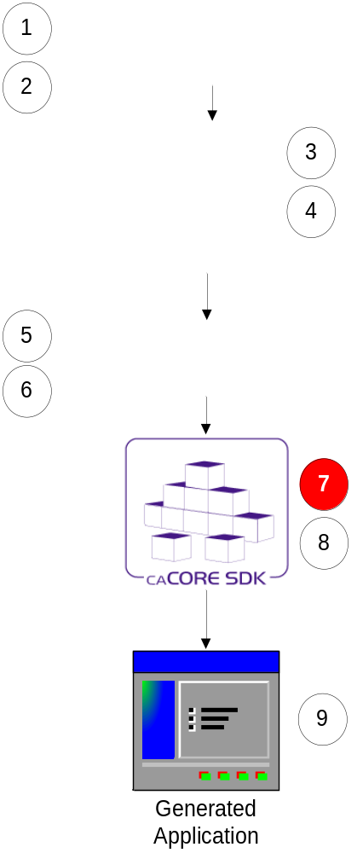
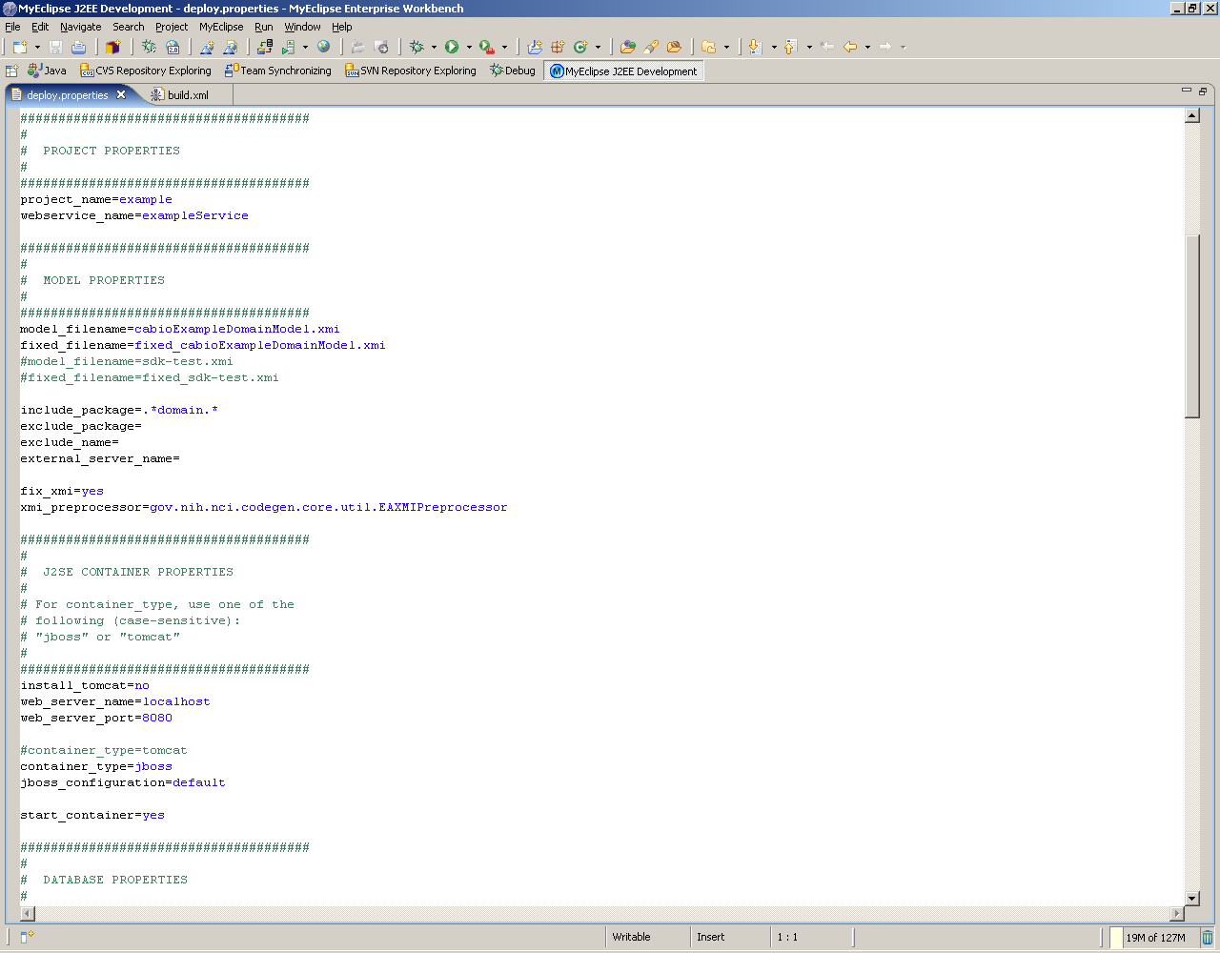
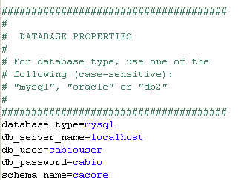
Step 7:
Configure Code Generator
Configuration defined in deploy.properties

Slide 17
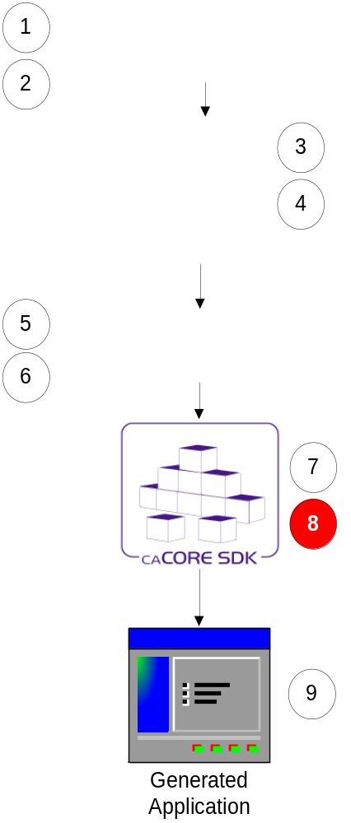
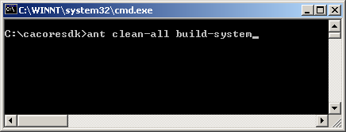
Step 8:
Run Code Generator
Put exported XMI file in caCORE SDK’s models/xmi directory
Go to command window
Execute build-system target

Slide 18
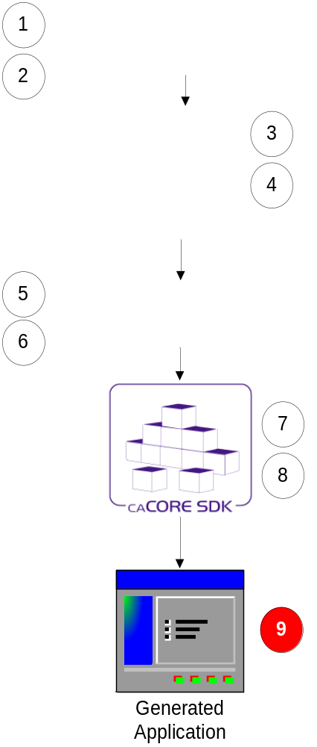
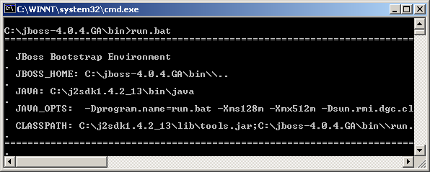
Step 9:
Running Generated System
Start application server

Slide 19
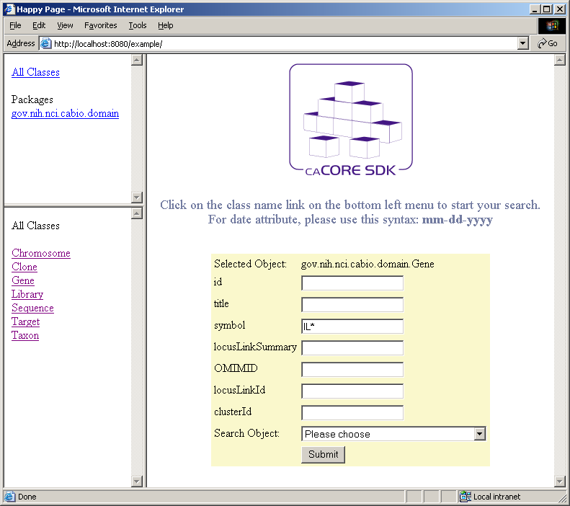
Testing Generated System (Web Interface)
Domain
Objects
Object
Query

Slide 20
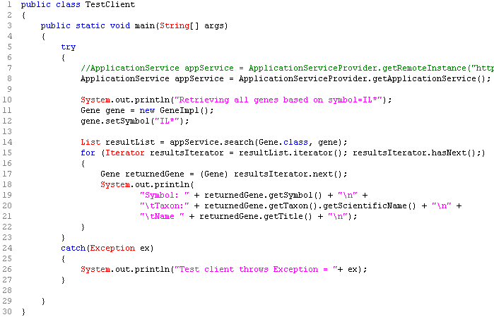
Testing Generated System (Java API)

Slide 21
Questions ???
SDK Users Mailing List
cacore_sdk_users-L@list.nih.gov

Slide 22
Demonstration (caBIO Example Model)
Open command window
Start → Run → cmd
Go to SDK’s home directory
cd c:\cacoresdk
Run code generator
ant clean-all build-system
Test user interface
http://localhost:8080/example
Test Java API client
cd c:\cacoresdk\output\example\package\client
ant rundemo

Slide 23
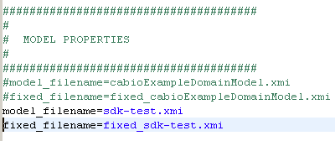
Demonstration (Test Model)
Edit c:\cacoresdk\conf\deploy.properties file
Before Edit
After Edit
Repeat instructions from the previous demo of caBIO example model

Slide 24
Demonstration (caBIO Example Model)
Open command window
Start → Run → cmd
Start JBoss
c:\jboss-4.0.4.demo\bin
Test user interface
http://localhost:8080/example
Test Java API client
cd c:\cacoresdkdemo\output\example\package\client
ant rundemo

Slide 25
Questions ???
SDK Users Mailing List
cacore_sdk_users-L@list.nih.gov

Slide 26
Generated Application – How Does It Look?
Typical n-tier architecture system
Presentation Tier
Business Tier
Persistence Tier
Database

Slide 27
Generated Application – How Does It Look?
n-tier architecture
Typical
Application
caCORE SDK Generated
Application
Presentation Tier
Web
UI
Web
Service
Remote
API
Business Tier
Query Translators / Security
Persistence Tier
Object Relational Mapping
Database
Database 1
Database 2

Slide 28
Generated Application – How Does It Look?
caCORE SDK Generated Server
CSM
Java Client
HTTP
Java
API
Security
remoting
Application
Service
Layer
Data
Source
Delegation
Object-
Relational
Mapping
Database
1
XML-HTTP
Client
HTTP
XML-HTTP
API
REST
Web Services
Client
Database
2
HTTP
Web
Services
API
SOAP
Non-ORM
Mapping

Slide 29
Questions ???
SDK Users Mailing List
cacore_sdk_users-L@list.nih.gov

